Slide 1
ROCKBUSTER STEALTH
DATA ANALYSIS PROJECT

Slide 2
Objectives and Analysis
These carefully curated questions will serve as a comprehensive guide for Rockbuster Stealth to assess its business performance, gain deep insights into customer behavior, and pinpoint opportunities for growth and improvement.
The analysis will focus on revenue trends, customer lifetime value, and operational challenges, empowering informed decision-making to ensure future growth and maintain a competitive edge in the market.

Slide 3
Business Questions
What is the distribution of film ratings based on their average length, rental duration, and rental rate?
Which countries are driving the highest revenue and customer engagement for Rockbuster Stealth, and what strategies can be implemented to further capitalize on these markets?
What are the most popular movie genres in different countries and how can Rockbuster Stealth optimize its movie selection and marketing strategies based on these findings?
Who are the top 5 high-value customers?

Slide 4
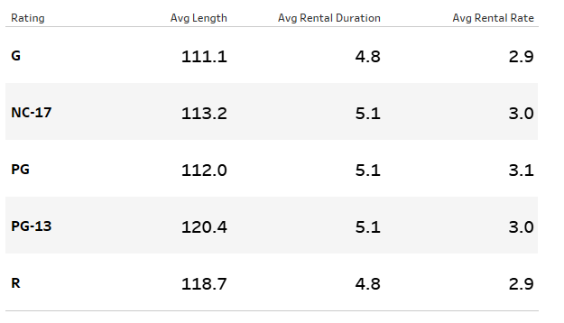
Film Rating Statistics: Average Length, Rental Duration, and Rental Rate
This slide presents essential statistics for different film ratings. It includes the average film length, average rental duration, and average rental rate for each rating category.
These insights provide valuable information about customer preferences and rental patterns for better decision-making.

Slide 5
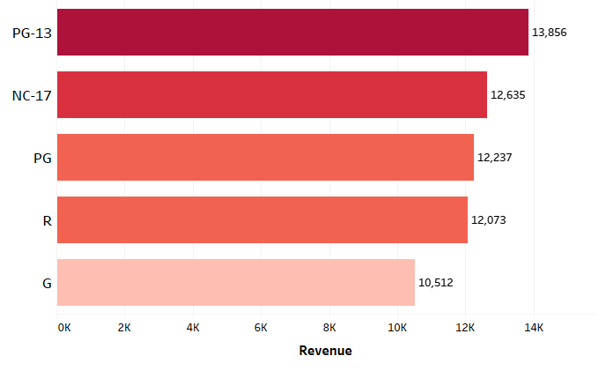
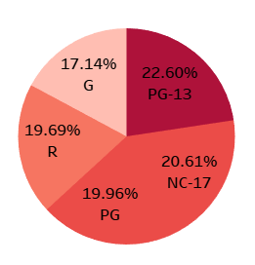
Film Rating Revenue and Percentage of Total Rating Revenue
The findings reveal the revenue generated by each film rating category. Notably, "PG-13" leads rating revenue, followed closely by "NC-17“, "PG," "R," and "G" also contribute significantly of the total rating revenue, respectively. Understanding the revenue distribution across film ratings is crucial for optimizing content selection and pricing strategies.

Slide 6
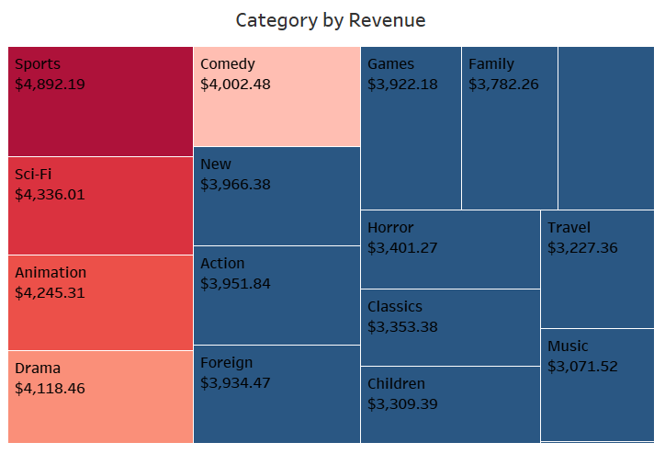
Revenue by Category Analysis
Revenue breakdown by movie category. "Sports" emerges as the top-performing category, followed closely by "Sci-Fi" and "Animation."
Understanding these revenue trends can help Rockbuster Stealth optimize its content offerings and drive further growth in the market.

Slide 7
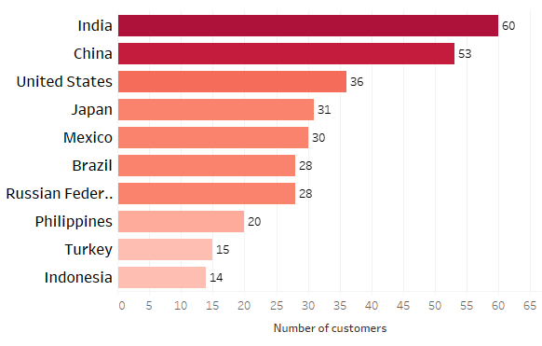
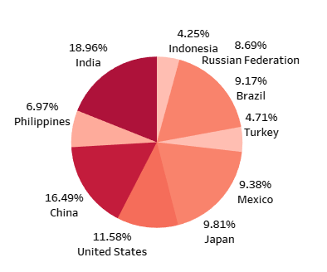
Top 10 Countries and Revenue Distribution
The data highlights the countries with the highest revenue shares, providing valuable insights into key markets for the company's growth and strategic focus.

Slide 8
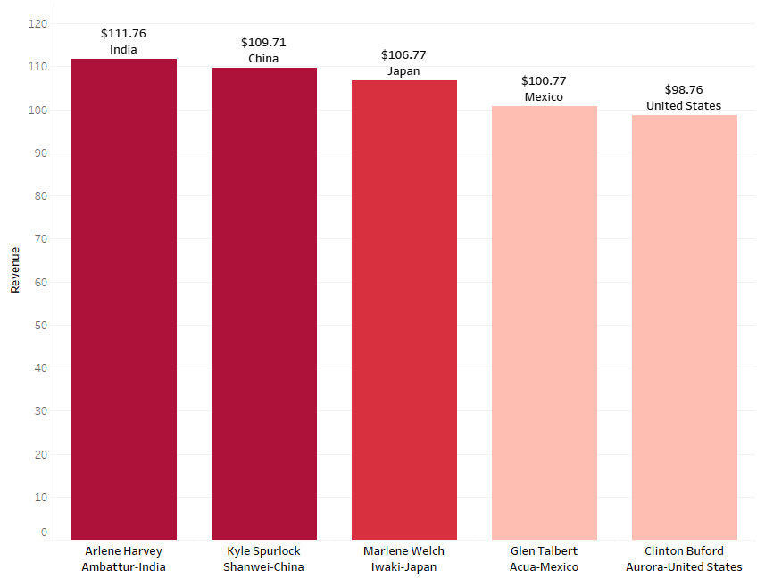
Top 5 Customers in Key Global Markets
These carefully chosen customers are from the highest revenue-generating countries globally: India, China, United States, Japan, and Mexico. Analyzing their preferences and behaviors reveals their significance in contributing to Rockbuster Stealth's success in these key markets.

Slide 9
Actions and Recommendations for Business Growth and Success
Top 10 Countries with High Revenue and Customer Engagement:
Allocate more resources and marketing efforts in these top-performing regions to capitalize on growth opportunities.
Identify operational challenges in lower-performing regions and explore strategies to improve customer engagement and revenue.
Top Movie Genres Impacting Rental Trends:
Adjust inventory and marketing strategies to cater to the popular movie genres in each region.
Explore partnerships or licensing deals to acquire more movies in high-demand genres.
Top 5 High-Value Customers:
Personalize offers and services for these high-value customers to enhance customer loyalty.
Implement loyalty programs and incentives to encourage repeat business and referrals.

Slide 10
Data Analyst: Facundo Arakaki
THANK YOU

